Slide 1

KIT - KalaignarKarunanidhi Institute of Technology ( An Autonomous Institution )
Department of Computer Applications
M23CAP401 - PROJECT WORK
Viva Voce
GUIDED BY,
PRESENTED BY,
Mr. R. PUNITHAVEL MCA (Ph.D),
ASSISTANT PROFESSOR (Sr.G),
DEPARTMENT OF MCA.
NAME : THARUNYA AMIRTHAM S,
REG NO : 711523MMC057,
II - MCA.

Slide 2
PROJECT TITLE
MITIGATING CYBER THREATS WITH NEXT-GEN AUTHENTICATION

Slide 3
ABSTRACT
To improve security, this project introduces Captcha as Graphical Passwords (CaRP), a novel authentication mechanism that integrates Captcha technology with graphical passwords to enhance security.
CaRP acts as both a Captcha and a graphical password system, offering protection against online guessing attacks, relay attacks, and shoulder-surfing attacks when combined with dual-view technologies.
This method makes it difficult for hackers to guess passwords because the images change every time a user logs in.
This project is also used to upload file, when uploading the files the secret key will be generated by using keygen algorithm.
Each uploaded files will have unique key and this key is forwarded to the user registered mail id and it’s used to download files, But without secret key this system will not allow download the file.

Slide 4
OBJECTIVES
The objective of this project is to design and implement a secure authentication system using Captcha as Graphical Passwords (CaRP) to enhance online security.
This system aims to integrate Captcha technology with graphical passwords, leveraging hard AI problems to mitigate various security threats such as online guessing attacks, relay attacks, and shoulder-surfing attacks.
The project seeks to develop a user-friendly yet robust authentication mechanism that overcomes the image hotspot problem found in traditional graphical password schemes.

Slide 5
EXISTING SYSTEM
Traditional Text-Based Password Systems: are widely used for online authentication but are vulnerable to brute-force, dictionary, phishing, and keylogging attacks.
CAPTCHA-Based Authentication: CAPTCHA is used to distinguish human users from bots. But It has usability issues like accessibility challenges and user frustration.
Graphical Password Authentication: A graphical password is an authentication method where users log in using images, patterns, or graphics instead of text, leveraging the human ability to recall visuals more easily. However, it is vulnerable to image hotspot issues, shoulder-surfing, and online guessing attacks.

Slide 6
EXISTING SYSTEM DISADVANTAGES
Users often choose predictable areas in images (like corners or faces), making passwords easier to guess through heatmap analysis.
Graphical passwords can still be cracked using brute force, automation, or machine learning to detect common patterns.
Attackers can observe and replicate the authentication process, making it vulnerable to shoulder surfing in public settings.
The process is slower than typing a password, potentially frustrating users in fast-paced environments.

Slide 7
PROPOSED SYSTEM
Our system generates new images for each login session, preventing predictable hotspots. The AI-resistant CAPTCHA images make it hard for automated bots to solve.
Our system replaces text passwords with a sequence of graphical elements from dynamically generated CAPTCHA images, preventing brute-force and dictionary attacks by presenting a new challenge each time.
Random image generation ensures passwords are not predictable.
Dual-view technology and constantly changing images improve security.

Slide 8
SYSTEM SPECIFICATIONS
HARDWARE SPECIFICATION
Processor : Intel Core i5 or higher
RAM : Minimum 8GB
Storage : Minimum 100GB HDD/SSD

Slide 9
SYSTEM SPECIFICATIONS
SOFTWARE SPECIFICATION
Front End : React.js
Back End : Node.js, Express.js
Date Base : MongoDB

Slide 10
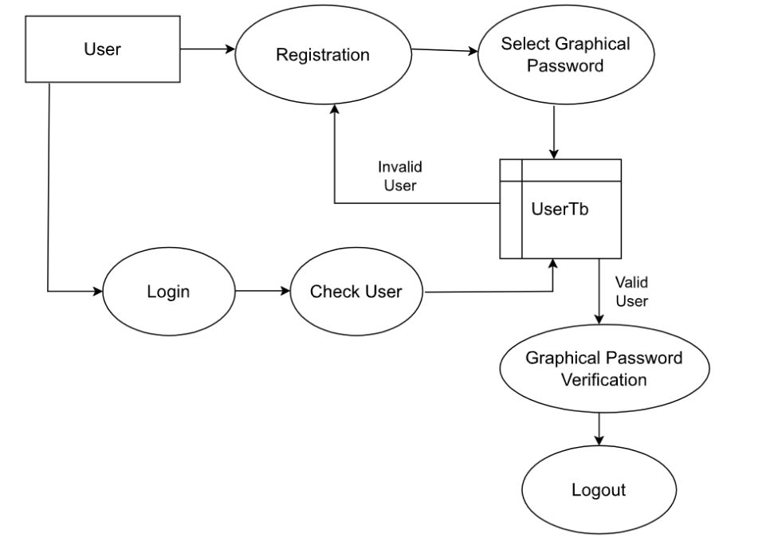
DATA FLOW DIAGRAM

Slide 11
MODULES DESCRIPTION
Visual Password Registration Module
Data Authentication Module
Attack guessing Module
Captcha Security Module
KeyGen Module

Slide 12
VISUAL PASSWORD REGISTRATION MODULE
Users create graphical passwords by selecting specific images within CAPTCHA-generated visuals.
Account registration requires basic details and interaction with an image-based CAPTCHA.
CAPTCHA images display dynamic objects or patterns; users select images in a defined order to form a password.
Each selected image is mapped to a unique identifier (e.g., coordinates or object IDs) for secure retrieval.
Password data is securely hashed, stored, and linked to the user’s account for future authentication.

Slide 13
DATA AUTHENTICATION MODULES
Login security is ensured using CAPTCHA challenges and browser cookie verification.
Visual password replication is required, matching the same image type and object sequence from registration.
Probabilistic matching algorithm allows slight variations, improving error tolerance without reducing security.
Rate-limiting and account lockout mechanisms prevent rapid guessing and unauthorized access.
Anti-relay tokens in API requests block credential replay and relay-based attacks.
Planned support for shoulder-surfing resistance includes dual-view CAPTCHA—clear to users, distorted to observers.

Slide 14
ATTACK GUESSING MODULE
Graphical passwords defend against brute-force and dictionary attacks by expanding the password space.
Image-based authentication makes credential guessing computationally difficult.
Probabilistic login responses (e.g., randomized CAPTCHA prompts) disrupt automated attacks.
Hotspot detection tracks commonly selected image areas and increases CAPTCHA complexity when clustering occurs.
Adaptive countermeasures include dynamic rate-limiting, fresh CAPTCHA challenges, and timed account lockouts.
Attack simulation feedback is used by the CAPTCHA Security Module to enhance image complexity and randomness.

Slide 15
CAPTCHA SECURITY MODULE
CaRP (Captcha as a Recognition-based Password) turns CAPTCHA images into secure graphical password inputs.
Resists AI and OCR-based attacks through complex object recognition and segmentation challenges.
Dynamically generated CAPTCHA images include random objects, shapes, grids, and distortions for secure password selection.
Real-time image complexity adjustment based on feedback from the Attack Guessing Module counters evolving threats.
Secure CAPTCHA delivery uses unique session identifiers to prevent reuse and replay attacks.

Slide 16
KEYGEN MODULE
Generates cryptographic keys for secure cloud-based file operations.
Derives keys from graphical passwords using a secure Key Derivation Function (KDF).
Creates session keys for JWT-based authentication to securely link users to sessions.
Generates AES-256 keys for encrypting and decrypting files in cloud storage.
Sends a unique secret key to the user’s email for verification during file upload/download.
Stores key hashes securely in the database with access restricted to authenticated users.
Supports key rotation on password changes or session expiration to ensure continued security

Slide 17
SECURE FILE STORAGE MODULE
Enables secure file storage, retrieval, and management for authenticated users.
Encrypts uploaded files with AES-256 keys from the KeyGen Module.
Delivers encrypted files securely during authenticated download requests.
Implements role-based access control, restricting users to their own files.
Maintains audit logs for tracking all file operations.

Slide 18
SYSTEM TESTING
Functionality Testing
Usability Testing
Performance Testing
Error Handling Testing
Compatibility Testing

Slide 19
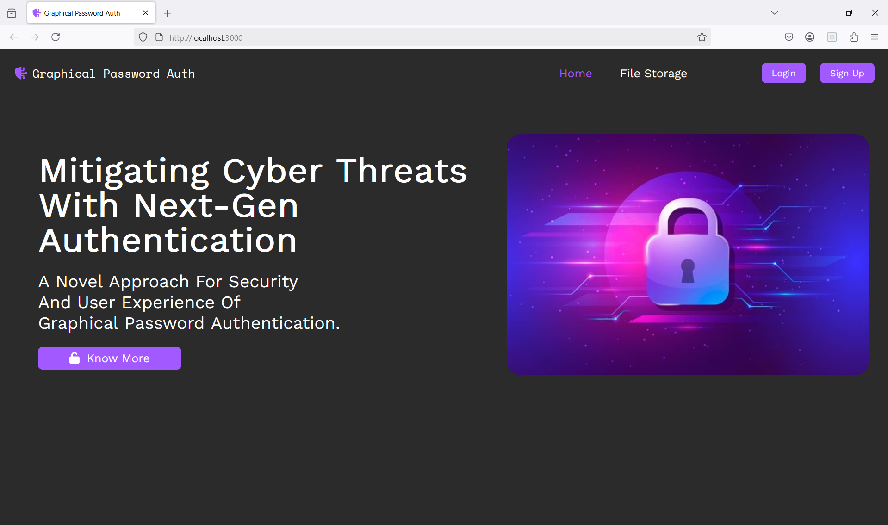
IMPLEMENTATION / RESULTS OF MODULE
Home Page

Slide 20
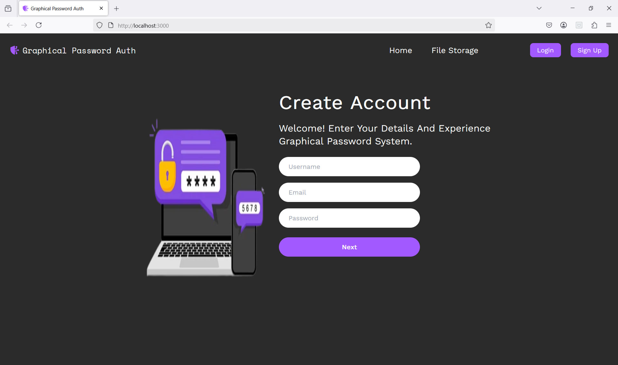
IMPLEMENTATION / RESULTS OF MODULE
Sign Up Page

Slide 21
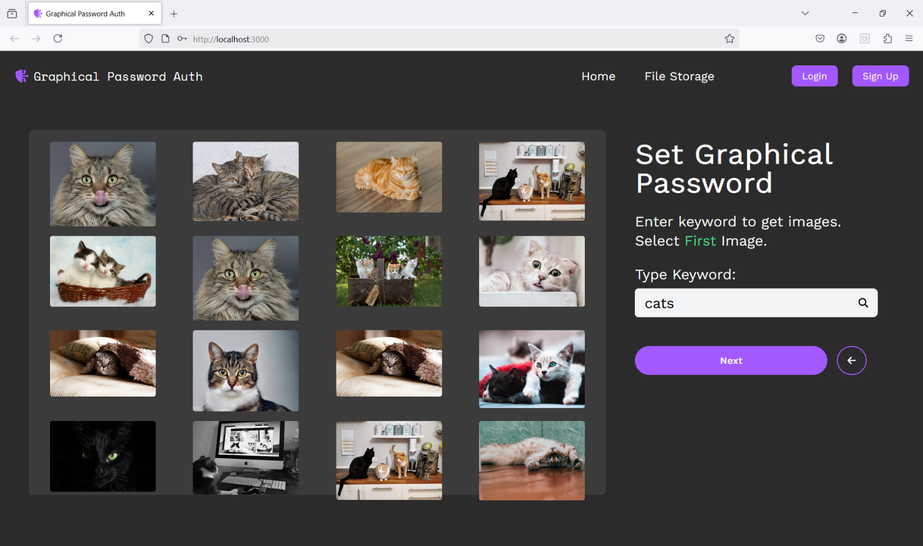
IMPLEMENTATION / RESULTS OF MODULE
Set Graphical Password Page

Slide 22
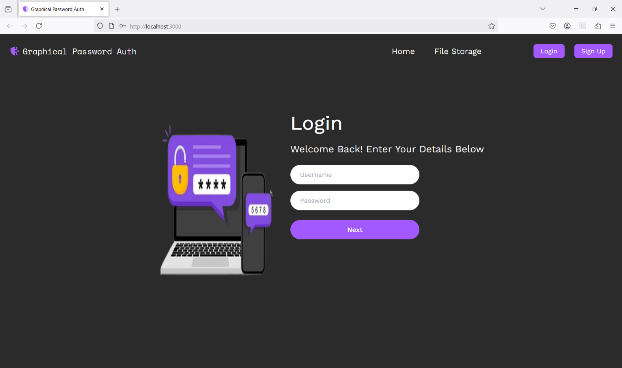
IMPLEMENTATION / RESULTS OF MODULE
Login Page

Slide 23
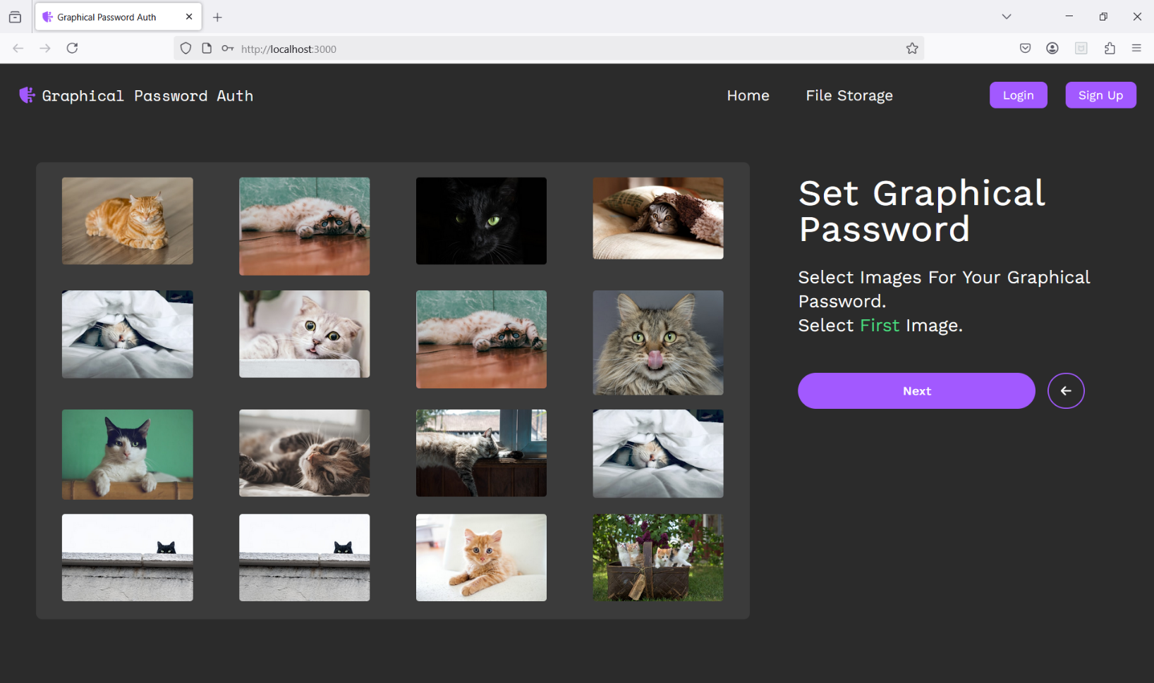
IMPLEMENTATION / RESULTS OF MODULE
Select Graphical Password Page

Slide 24
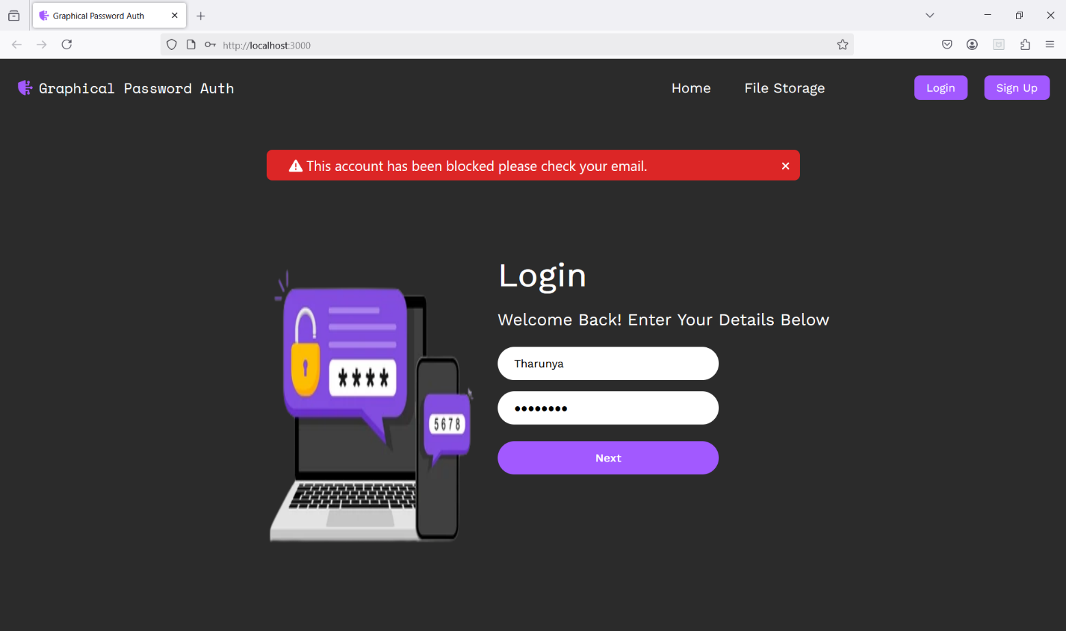
IMPLEMENTATION / RESULTS OF MODULE
Account Blocked for Wrong Password Page

Slide 25
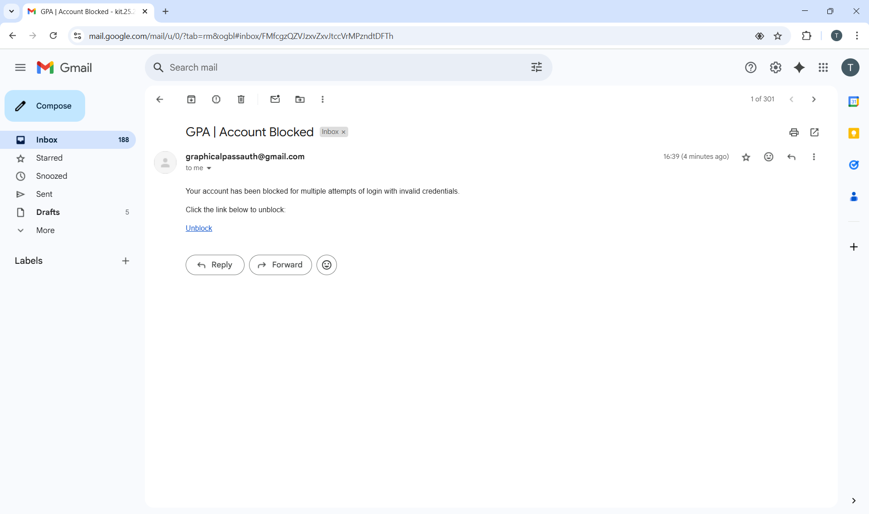
IMPLEMENTATION / RESULTS OF MODULE
Account Blocked Email Page

Slide 26
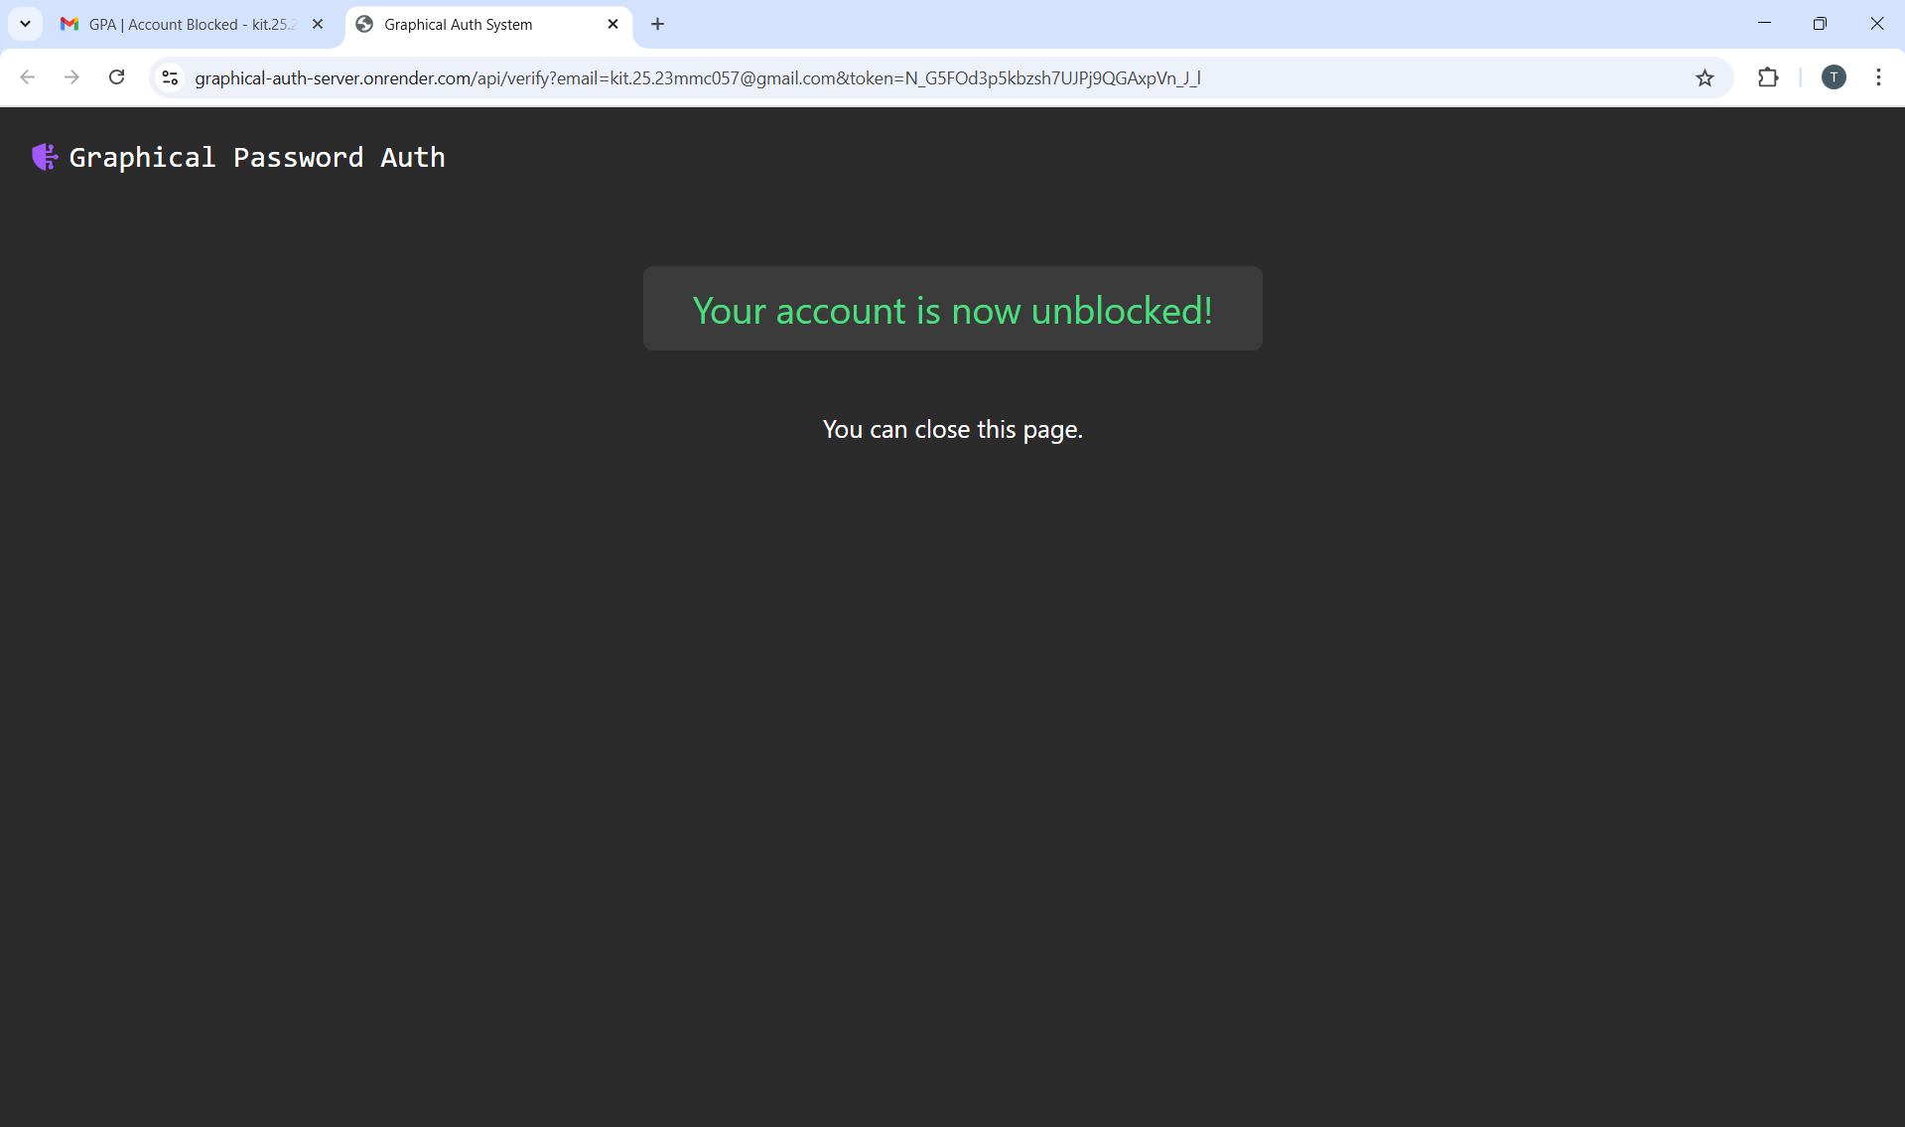
IMPLEMENTATION / RESULTS OF MODULE
Account Unblocked Page

Slide 27
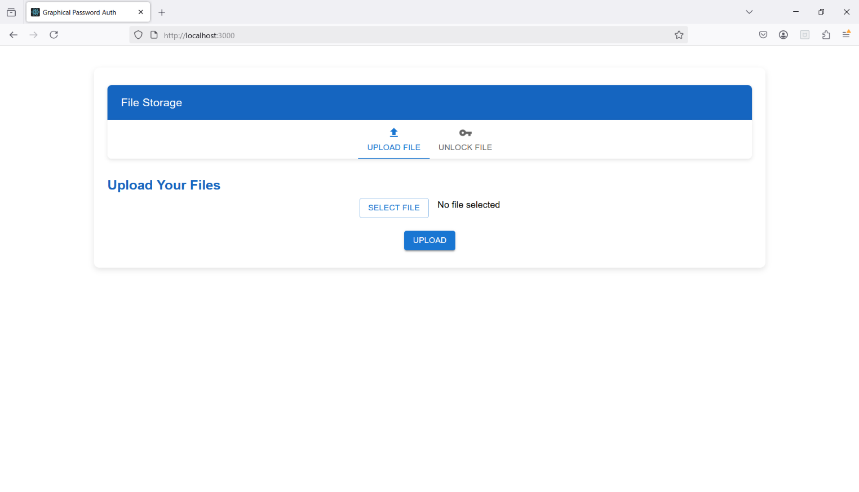
IMPLEMENTATION / RESULTS OF MODULE
File Upload Page

Slide 28
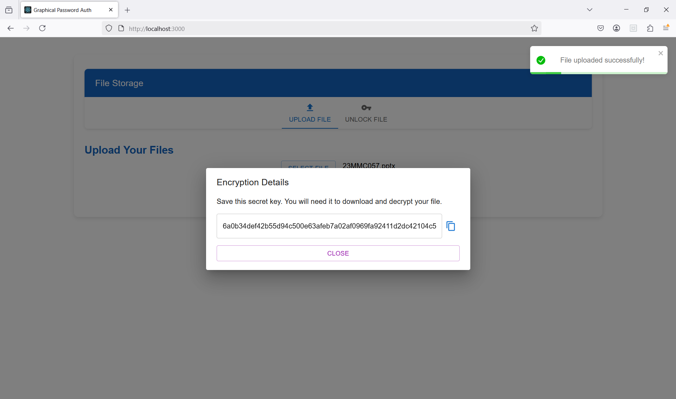
IMPLEMENTATION / RESULTS OF MODULE
File Uploaded Successfully Page

Slide 29
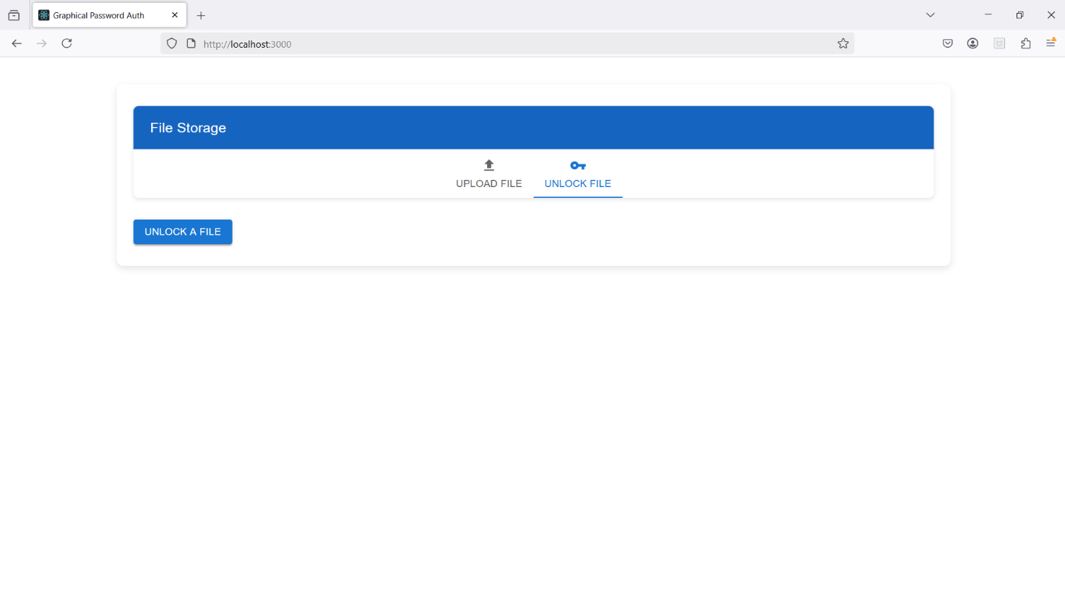
IMPLEMENTATION / RESULTS OF MODULE
File Download Page

Slide 30
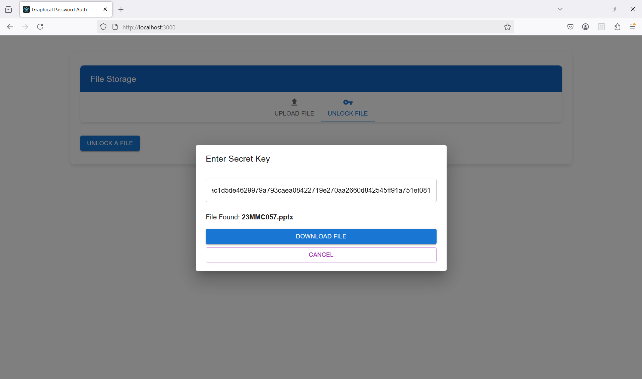
IMPLEMENTATION / RESULTS OF MODULE
File Download Successfully

Slide 31
CONCLUSION
Combines graphical passwords, secure file handling, and multi-layered authentication for robust digital security.
Introduces innovative authentication design, setting a new benchmark in cybersecurity.
Balances security with usability, making it accessible even for non-technical users.
Emphasizes intuitive design and strong encryption, meeting both technical and practical needs.
Serves as a roadmap for building secure, user-friendly, and future-ready digital ecosystems.
Establishes a new standard in resilient and user-centric authentication, advancing digital trust and cyber defense.

Slide 32
FUTURE ENHANCEMENT
Cloud Integration: Enabling scalable, cloud-based deployment for better access, maintenance, and secure backups.
User Feedback & Customization: Including usability testing and features like theme personalization and smart password tools.
Continuous Updates & Threat Intelligence: Ensuring the system stays current with evolving threats and security patches.
AI-Powered Threat Detection: Using machine learning to identify suspicious behavior and respond to threats in real-time.
Advanced Multi-Factor Authentication: Implementing adaptive MFA that changes based on user behavior and context.

Slide 33
REFERENCE
Cybersecurity Essentials by Charles J. Brooks, Christopher Grow, Philip Craig, and Donald Short – 2022
Authentication: From Passwords to Public Keys by Richard E. Smith – 2021
Zero Trust Networks: Building Secure Systems in Untrusted Networks by Evan Gilman and Doug Barth – 2020
Network Security Essentials: Applications and Standards by William Stallings – 2023
Digital Identity and Access Management: Technologies and Frameworks by Leandro Froes – 2022
Practical Cybersecurity Architecture by Ed Moyle and Diana Kelley – 2021
Applied Cryptography: Protocols, Algorithms, and Source Code in C by Bruce Schneier – 2022

Slide 34
THANK YOU

